Slide 1



BRAND R.Comm, Rural Communication Summit & Awards 2024
BRIEF SUMMARY

Slide 2



Inaugural Session – Formulating a Roadmap for Rural Communications;
Taking into account the socio-economic conditions and cultural specifics of the targeted rural communities
Setting achievable goals that align with broader development agendas and contribute to sustainable outcomes in rural areas
01
+91 9354342588, 8750807676 | Email: info@snailintegral.com | www.snailintegral.com

Slide 3

Panel 01: Science of Communication - Understanding and bridging the communication gaps from 'Land to Lab' and from 'Lab to Land’
Bridging the communication gaps between these realms is crucial for fostering collaboration, innovation, and sustainable development.
Enabling the seamless exchange of knowledge and insights between rural environments and research laboratories
02
+91 9354342588, 8750807676 | Email: info@snailintegral.com | www.snailintegral.com

Slide 4

Panel 02: Embracing Change & Transformation in Artificial Intelligence, Digital Infrastructure, Chemicals and Financial (Credit) Communication
Leveraging AI to enhance decision-making processes, optimize operations, and drive innovation
Leveraging Technology for Last-Mile Connectivity
Strategies for fostering community engagement and participation in communication initiatives.
03
+91 9354342588, 8750807676 | Email: info@snailintegral.com | www.snailintegral.com

Slide 5

Panel 03: Media Trends 2024 – Shaping the Way Brands Communicate
Leveraging augmented reality (AR) and virtual reality (VR) technologies
Harnessing the power of User-Generated Content (UGC) to build trust, foster community engagement, and amplify their brand message across diverse channels
Sustainable and Inclusive Communication
04
+91 9354342588, 8750807676 | Email: info@snailintegral.com | www.snailintegral.com

Slide 6

Panel 04 - Vocal for Local: Level Up Communication Strategy for Nationwide Engagement.
Amplifying the "Vocal for Local" message and foster nationwide engagement.
Elevating communication strategies that prioritize authenticity, digital engagement, collaboration, community outreach, consumer empowerment, partnerships, and measurement
05
+91 9354342588, 8750807676 | Email: info@snailintegral.com | www.snailintegral.com

Slide 7


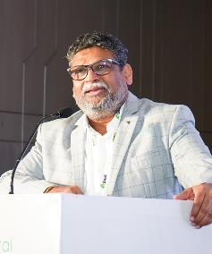
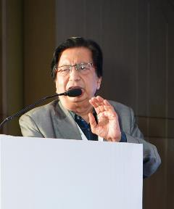

Brand Presentations
Shri Suresh Reddy, President, KREPL on 50 years Saga KRISHI RASAYAN EXPORTS PVT. LTD
Shri Harish Mehta, Sr. Advisor, CCFI on Role of crop care federation of India (CCFI) in creating awareness among farmers contract labour and women
Shri Sumit Gupta, Director, Thakar Chemicals Limited on Feel Secure with Pure with Thakar Chemicals Limited
Shri Suresh Reddy
President
Krishi Rasayan Export Pvt. Ltd.
Shri Harish Mehta
Sr. Advisor
Crop Care Federation of Inda
Shri Sumit Gupta
Director (Projects)
Thakar Chemicals Limited
21st March 2024 Hotel Holiday Inn, Aerocity, New Delhi
06
+91 9354342588, 8750807676 | Email: info@snailintegral.com | www.snailintegral.com

Slide 8

CEO & Director Panel for Future Prospects
Exploring innovative technologies and solutions to bridge the digital divide in rural areas
Examining approaches to minimize environmental impact, ensure cultural sensitivity, and promote social equity in communication interventions.
07
+91 9354342588, 8750807676 | Email: info@snailintegral.com | www.snailintegral.com

Slide 9



AWARDS
CEREMONY
08
+91 9354342588, 8750807676 | Email: info@snailintegral.com | www.snailintegral.com

Slide 10


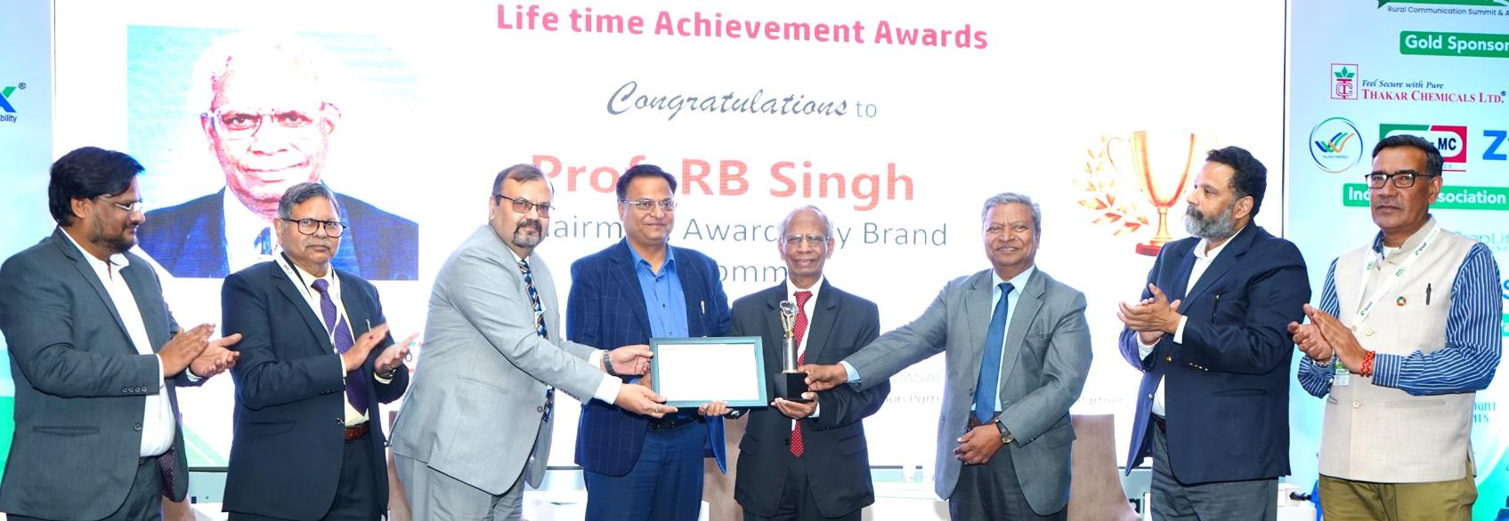
LIFETIME ACHIEVEMENT AWARD
Dr. RB SINGH
09
+91 9354342588, 8750807676 | Email: info@snailintegral.com | www.snailintegral.com

Slide 11

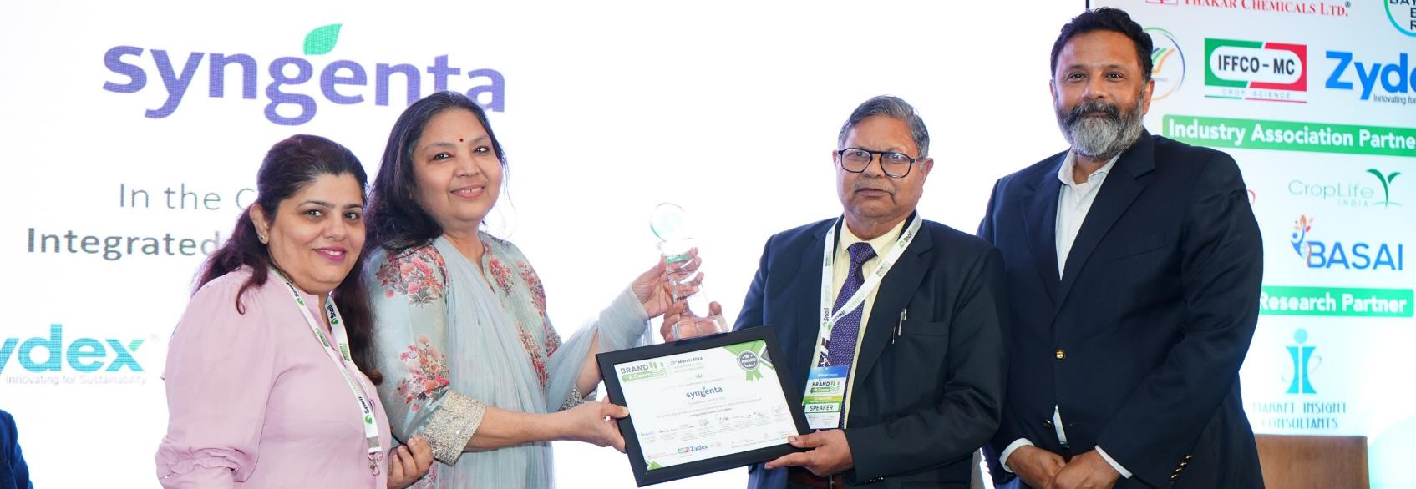
INTEGRATED COMMUNICATION AWARD
10
+91 9354342588, 8750807676 | Email: info@snailintegral.com | www.snailintegral.com

Slide 12

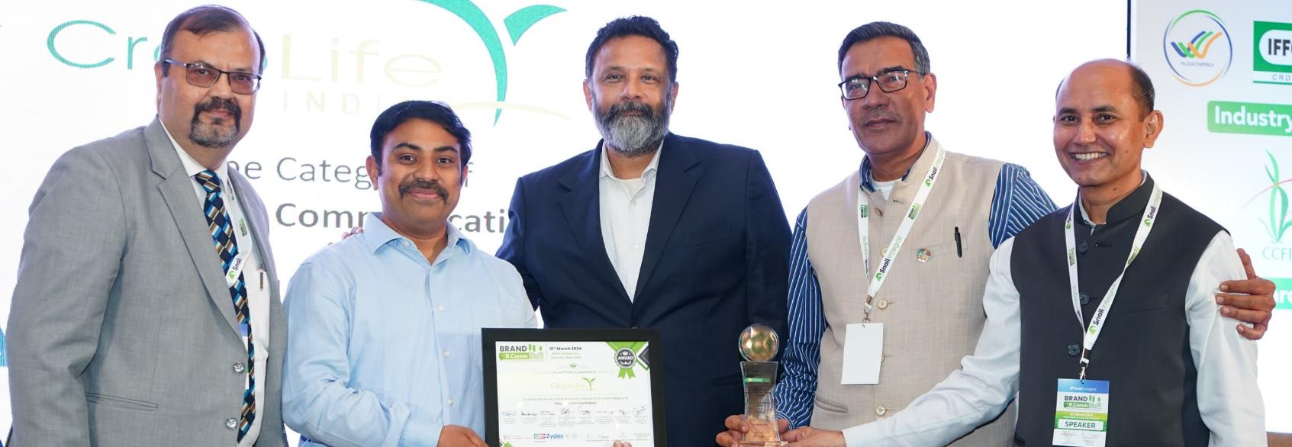
INTEGRATED COMMUNICATION AWARD
11
+91 9354342588, 8750807676 | Email: info@snailintegral.com | www.snailintegral.com

Slide 13

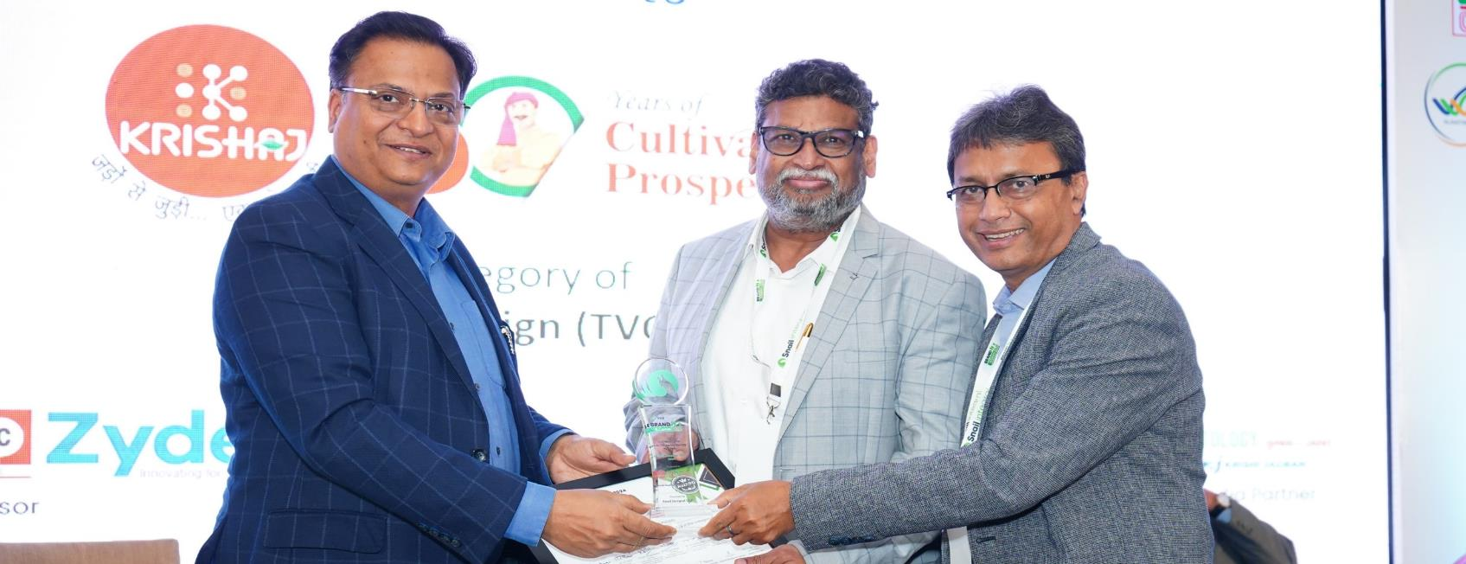

BRAND CAMPAIGN (TVC) AWARD
12
+91 9354342588, 8750807676 | Email: info@snailintegral.com | www.snailintegral.com

Slide 14


DIGITAL MARKETING AWARD
13
+91 9354342588, 8750807676 | Email: info@snailintegral.com | www.snailintegral.com

Slide 15

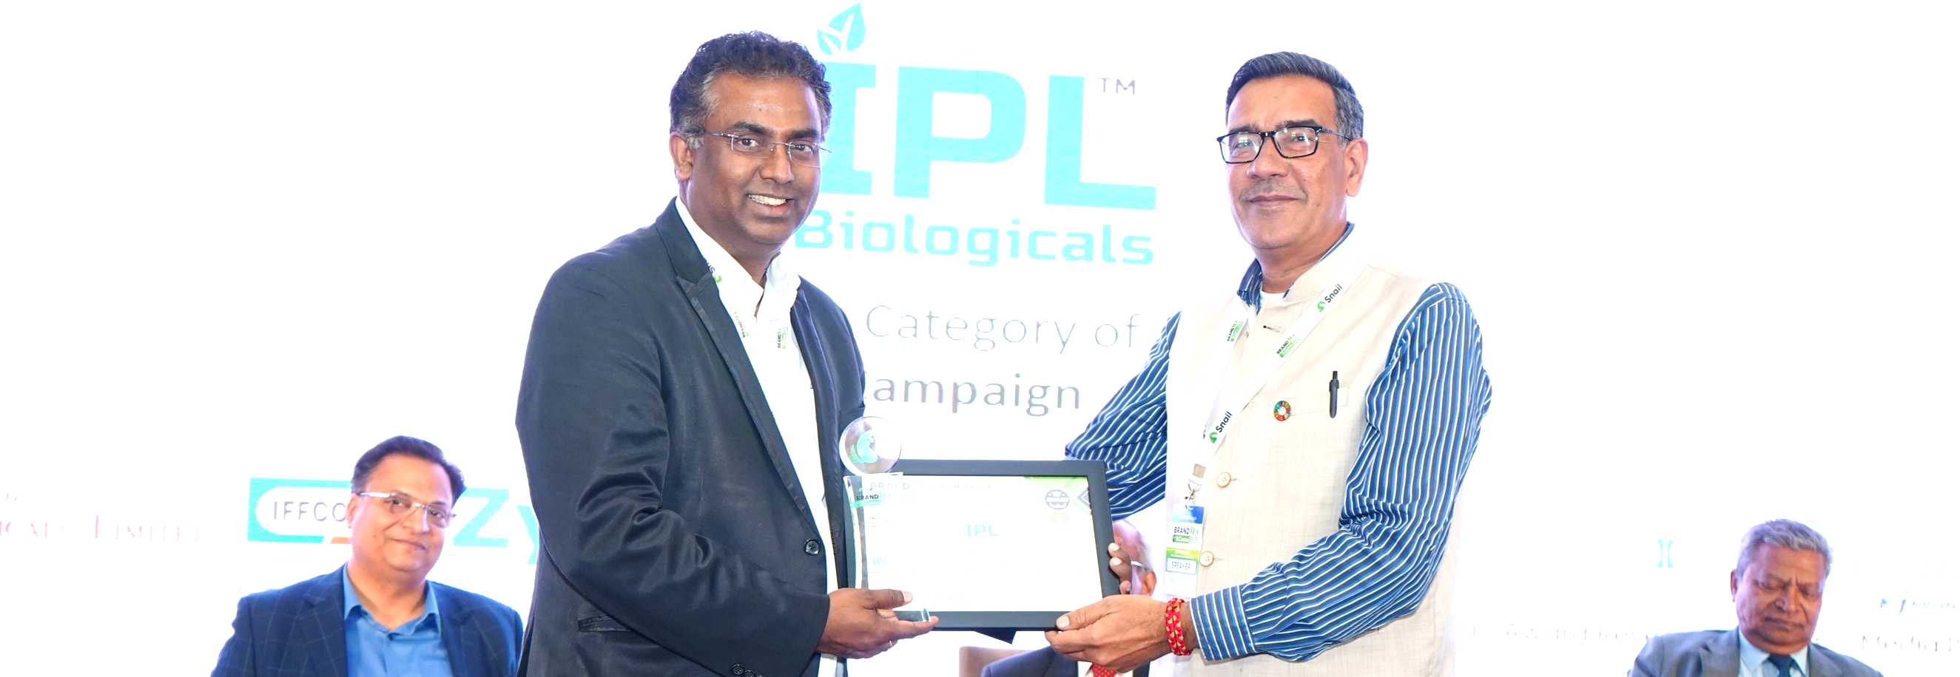
PR CAMPAIGN AWARD
14
+91 9354342588, 8750807676 | Email: info@snailintegral.com | www.snailintegral.com

Slide 16

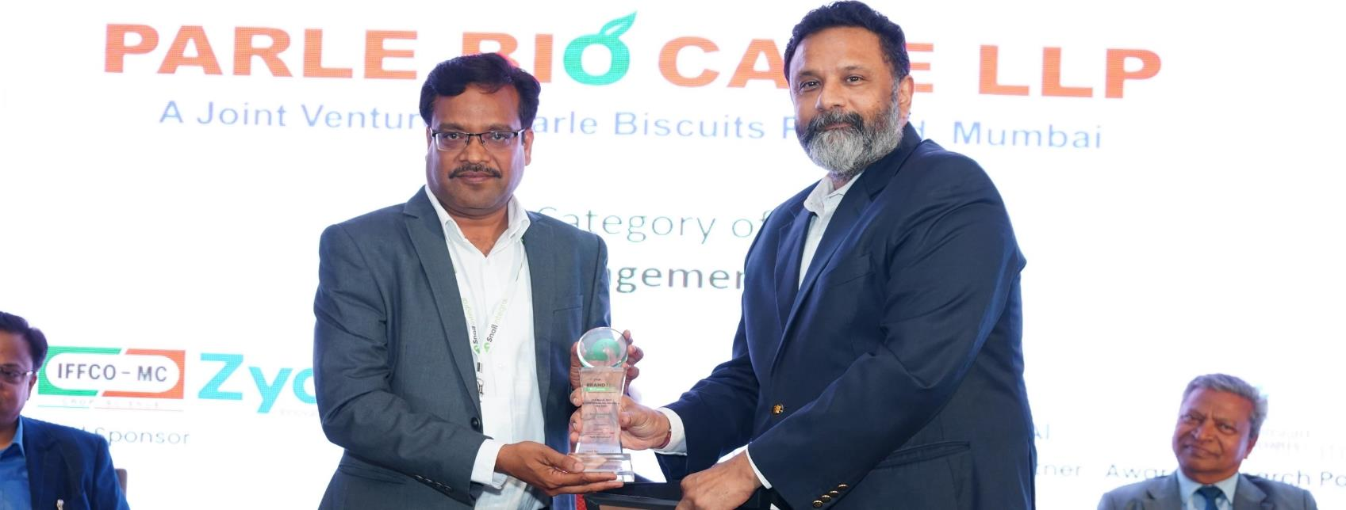
RURAL ENGAGEMENT AWARD
15
+91 9354342588, 8750807676 | Email: info@snailintegral.com | www.snailintegral.com

Slide 17

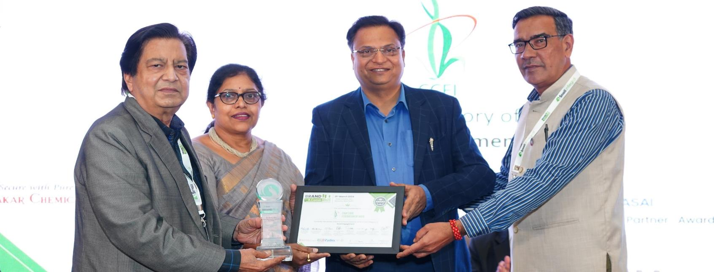
RURAL ENGAGEMENT AWARD
CROP CARE FEDERATION OF INDIA
16
+91 9354342588, 8750807676 | Email: info@snailintegral.com | www.snailintegral.com

Slide 18

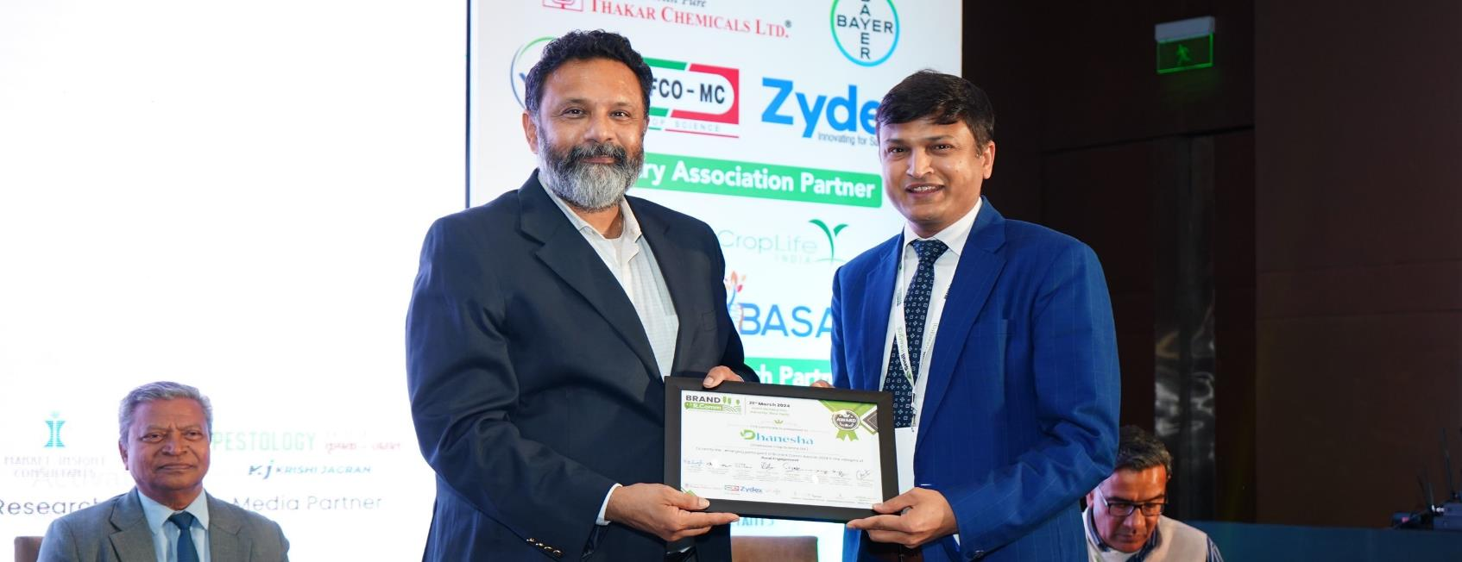
EMERGING PARTICIPANT FOR RURAL ENGAGEMENT AWARD
17
+91 9354342588, 8750807676 | Email: info@snailintegral.com | www.snailintegral.com

Slide 19

REACH
PRE EVENT (DIGITAL & PRINT)
ON-EVENT
POST EVENT (PUBLIC RELATION)
18
+91 9354342588, 8750807676 | Email: info@snailintegral.com | www.snailintegral.com

Slide 20


DIGITAL REACH
19
+91 9354342588, 8750807676 | Email: info@snailintegral.com | www.snailintegral.com

Slide 21
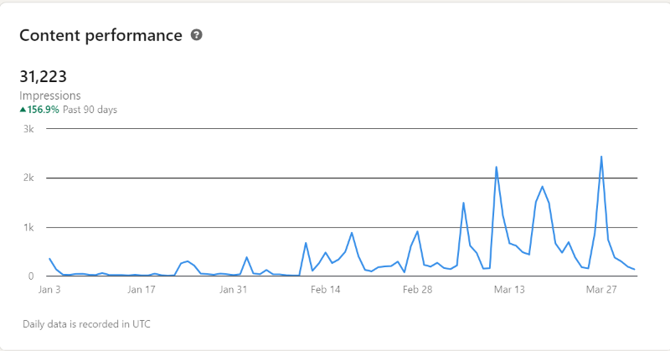

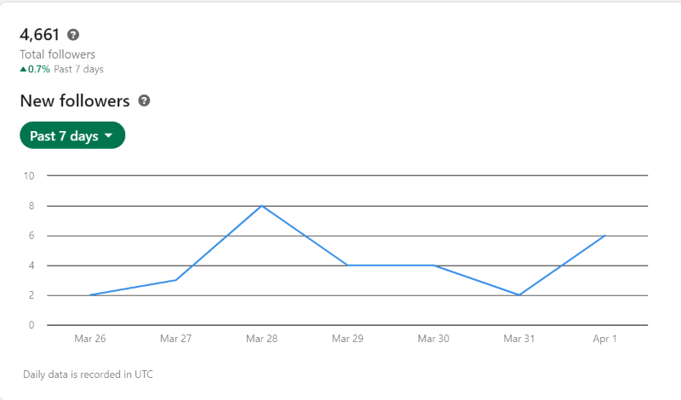
ANALYSIS
Impression
Reach
31,223
4,661
20
+91 9354342588, 8750807676 | Email: info@snailintegral.com | www.snailintegral.com

Slide 22
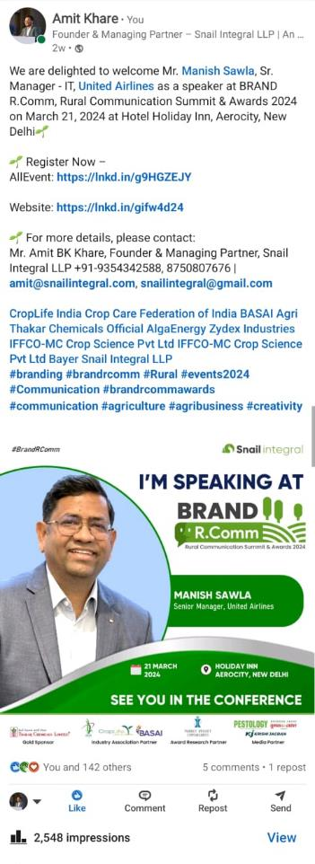
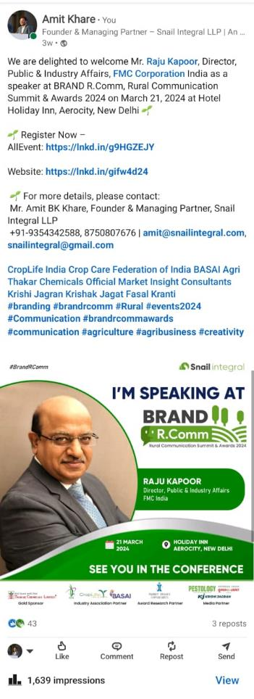
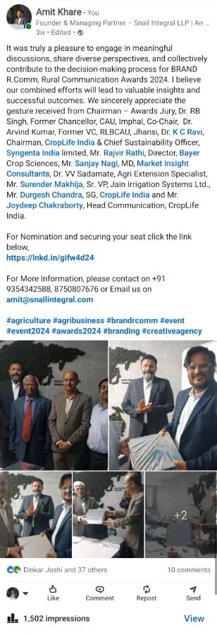
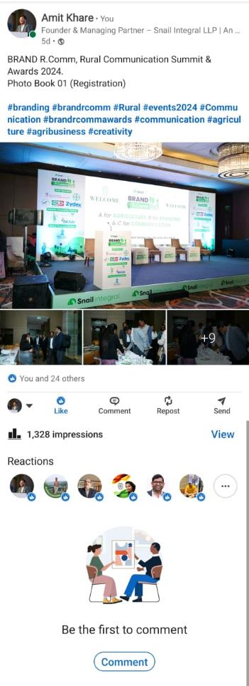
ANALYSIS
Most
Popular
Posts
21
+91 9354342588, 8750807676 | Email: info@snailintegral.com | www.snailintegral.com

Slide 23


PRINT AD
COVERAGE
Pestology
Krishak Jagat
22
+91 9354342588, 8750807676 | Email: info@snailintegral.com | www.snailintegral.com

Slide 24

ON-EVENT REACH
23
+91 9354342588, 8750807676 | Email: info@snailintegral.com | www.snailintegral.com

Slide 25
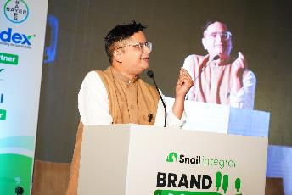
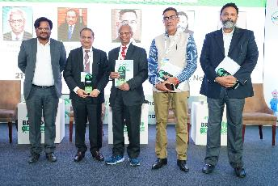
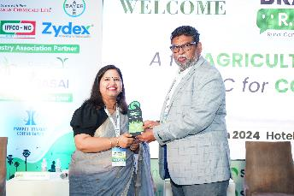
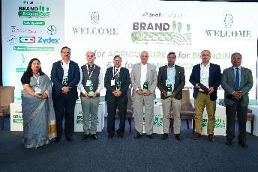
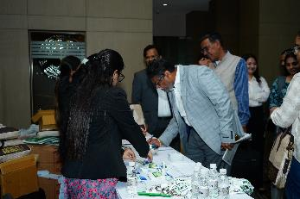
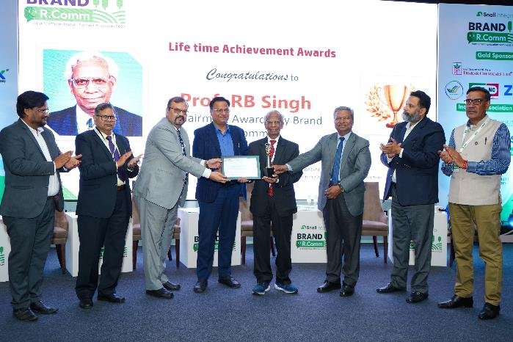
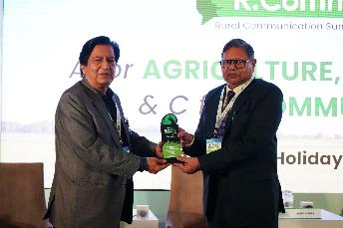

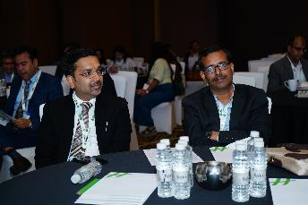
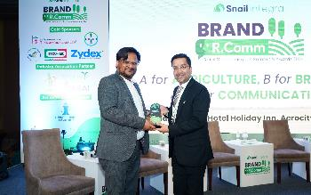
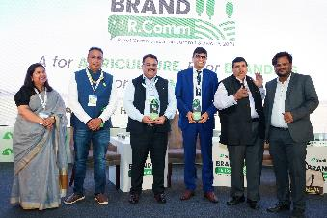
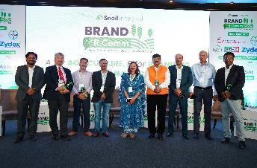

ON EVENT
ANALYSIS
150+
Senior Delegates from Industry
35+
Speakers from Industry in Panel Discussion and Brand Presentation
7+
Awards in various category including ‘Lifetime Achievement Awards’
24
+91 9354342588, 8750807676 | Email: info@snailintegral.com | www.snailintegral.com
Impression

Slide 26

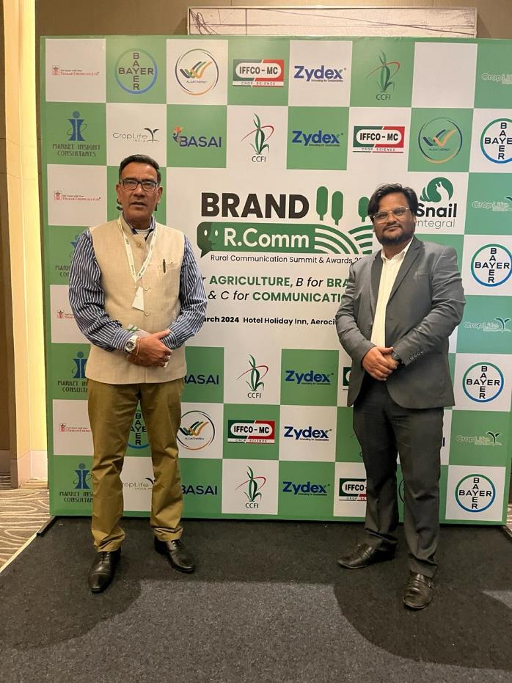

ON EVENT
ANALYSIS
ORU
Optimum Resource Utilization for Sponsors Branding
FGF
Feel Good Factor for the delegates who attend the Conference
FEK
First Ever of its Kind conference on Rural Communication
25
+91 9354342588, 8750807676 | Email: info@snailintegral.com | www.snailintegral.com

Slide 27
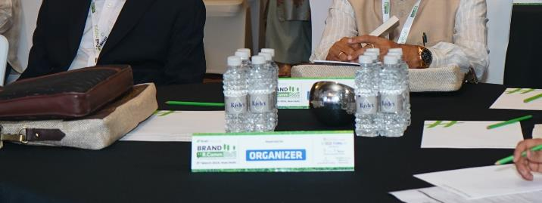






ON EVENT
ANALYSIS
ORU
Optimum Resource Utilization for Sponsors Branding
FGF
Feel Good Factor for the delegates who attend the Conference
FEK
First Ever of its Kind conference on Rural Communication
26
+91 9354342588, 8750807676 | Email: info@snailintegral.com | www.snailintegral.com

Slide 28

REACH
27
+91 9354342588, 8750807676 | Email: info@snailintegral.com | www.snailintegral.com

Slide 29
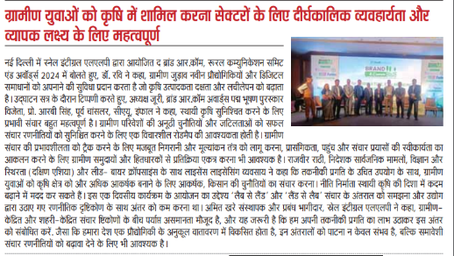


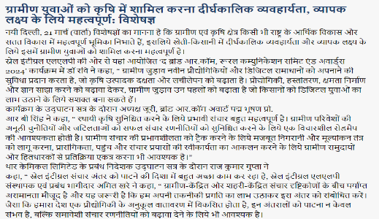

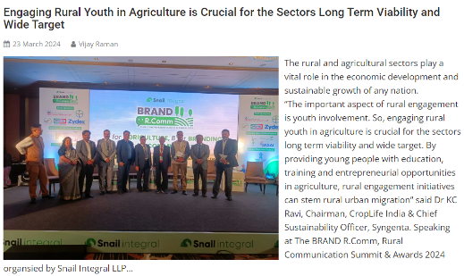



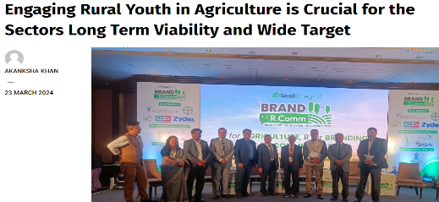
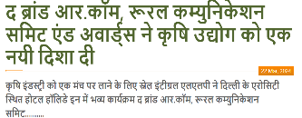

PUBLIC RELATION
ANALYSIS
50+
Online & Imprint Impression
28
+91 9354342588, 8750807676 | Email: info@snailintegral.com | www.snailintegral.com

Slide 30

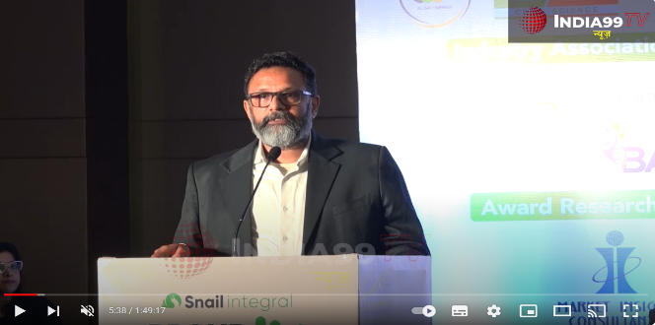
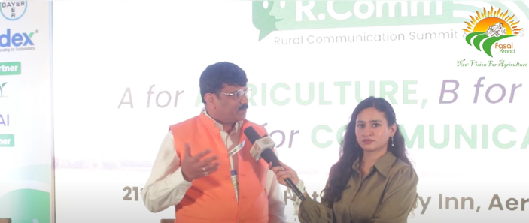
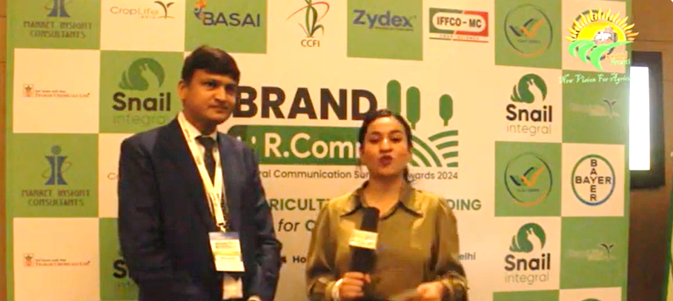
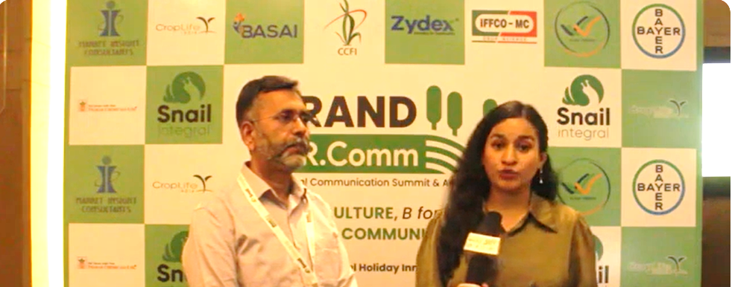
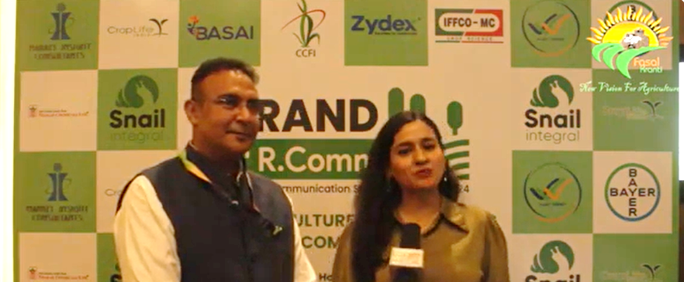
PUBLIC RELATION
ANALYSIS
20+
Media Interaction & Interview
29
+91 9354342588, 8750807676 | Email: info@snailintegral.com | www.snailintegral.com

Slide 31
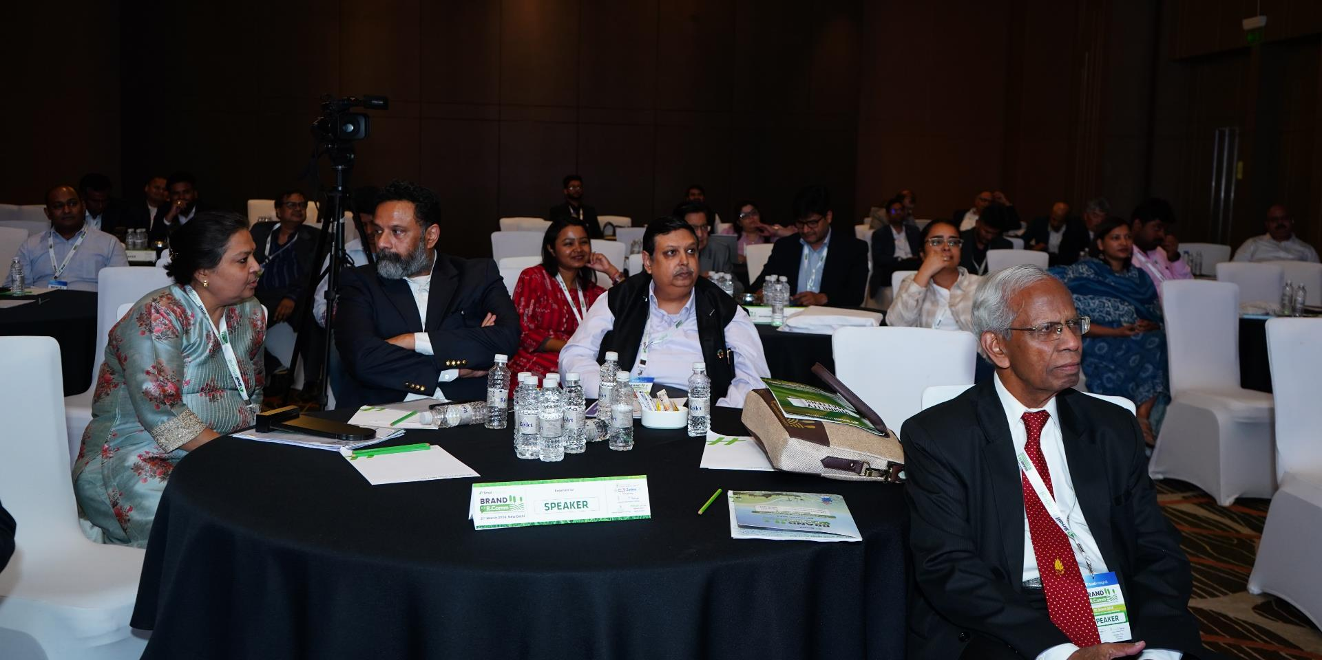

AS ANNOUNCED DURING THE CONFERENCE
The 2nd Edition of
BRAND R.Comm, Rural Communication Summit
NOVEMBER 2024
SECOND EDITION
Inviting Participation and Support
30
+91 9354342588, 8750807676 | Email: info@snailintegral.com | www.snailintegral.com

Slide 32
















A for AGRICULTURE, B for BRANDING & C for COMMUNICATION
THANKS TO THIS OVERWHELMING SUPPORT
OUR SPONSORS
INDUSTRY ASSOCIATION PARTNERS
MEDIA
PARTNERS
AWARD RESEARCH
PARTNER

